Slide 1
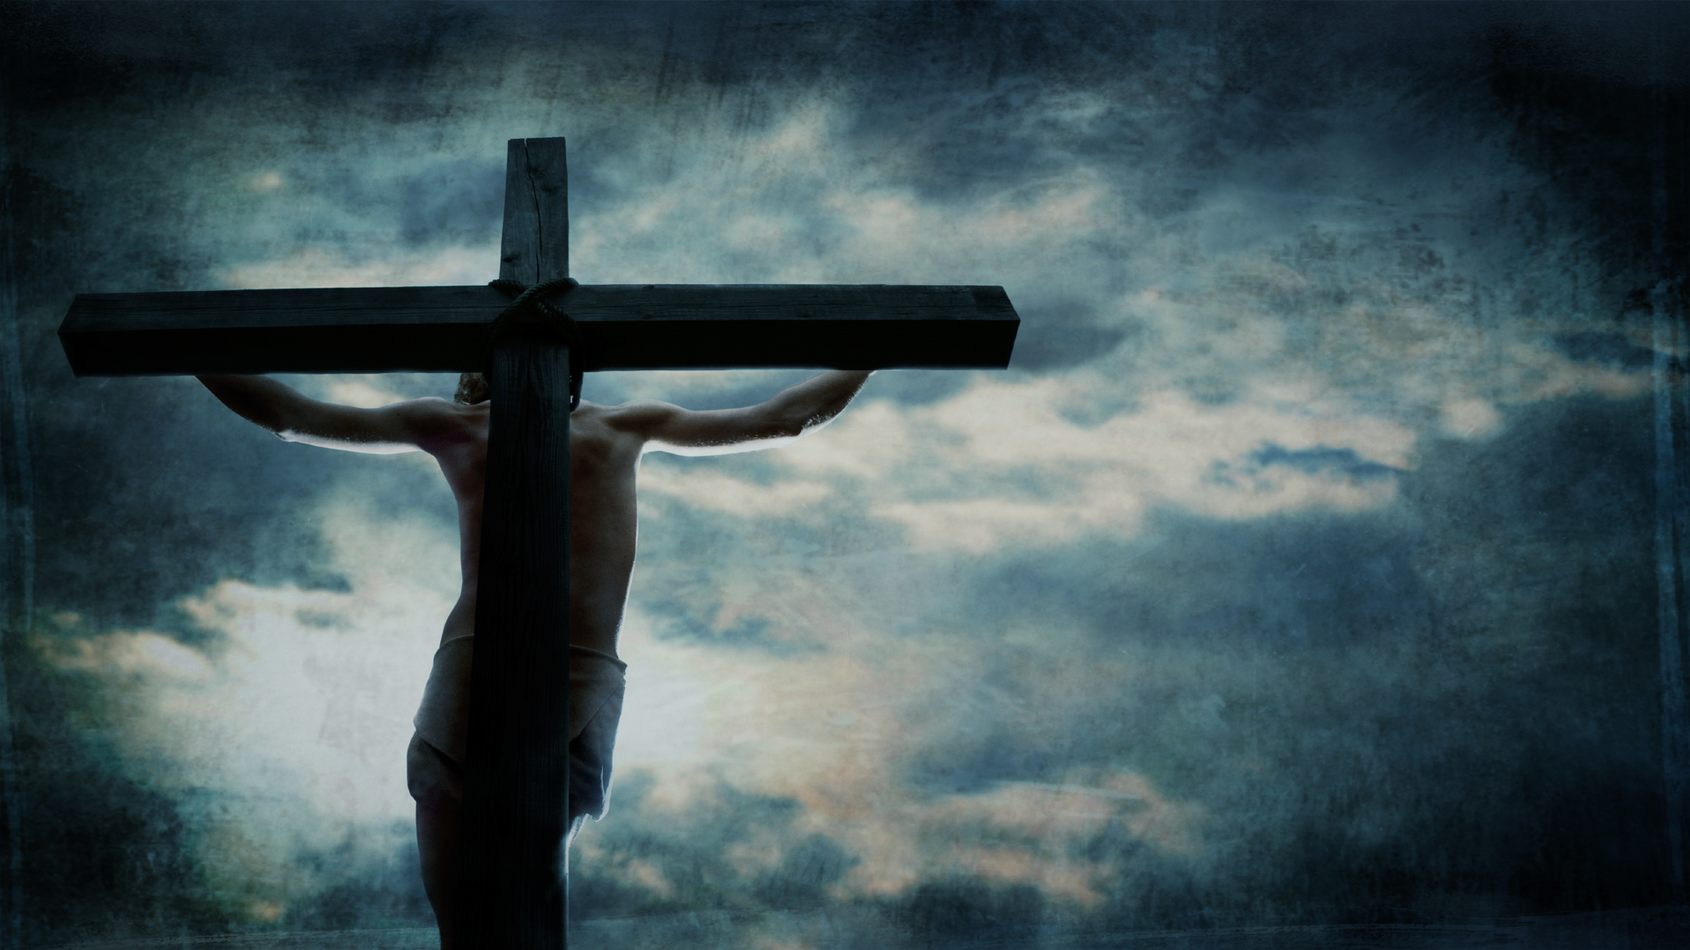



the seven last sayings
cross
of Christ from the
a free cd of this message will be available following the service
also, you may obtain a podcast in a few days at calvaryokc.com

Slide 2

the seven last sayings of Christ from the cross
  1. Luke 23.34
2. Luke 23.43
3. John 19.26-27
4. Matt. 28.46
5. John 19.28
6. John 19.30
7. Luke 23.46

Slide 3
first
saying
the seven last sayings of Christ from the cross
1. Luke 23.34 ~ Then Jesus said, “Father, forgive them, for they do not know what they do.” And they divided His garments and cast lots.

Slide 4
first
saying
1. He knew the people were blinded by their sin
2. Satan's last-ditch effort to foil Gen. 3:15
~ “And I will put enmity
Between you and the woman,
And between your seed and her Seed;
He shall bruise your head,
And you shall bruise His heel.”
the seven last sayings of Christ from the cross

Slide 5
first
saying
the seven last sayings of Christ from the cross

Slide 6
first
saying
They hauled him trembling, before the Judgment Seat.
“Oh, Lord, behold the man who made the nails that pierced Thy hands and feet.”
The Master laid a thin, scarred hand upon the shame-browed head.
“They were good nails,” He said.
Ps. 22.18 ~ They divide My garments among them,
And for My clothing they cast lots.
the seven last sayings of Christ from the cross

Slide 7
first
saying
the seven last sayings of Christ from the cross

Slide 8
second
first
saying
2. Luke 23.43 ~ And Jesus said to him, “Assuredly, I say to you, today you will be with Me in Paradise.”
the seven last sayings of Christ from the cross

Slide 9

second
saying
Sheol / Hades
Great Gulf
Abraham’s Bosom
Place of Torment
the seven last sayings of Christ from the cross

Slide 10
second
saying
the seven last sayings of Christ from the cross

Slide 11
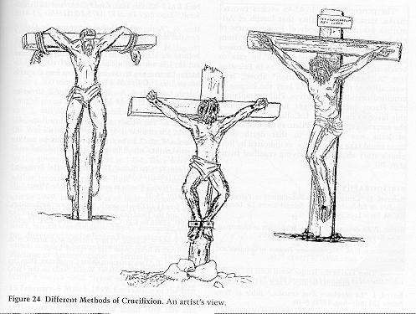
third
second
saying
3. John 19.26-27 ~ ²⁶ When Jesus therefore saw His mother, and the disciple whom He loved standing by, He said to His mother, “Woman, behold your son!” ²⁷ Then He said to the disciple, “Behold your mother!” And from that hour that disciple took her to his own home.
the seven last sayings of Christ from the cross

Slide 12
third
saying
the seven last sayings of Christ from the cross

Slide 13
fourth
third
saying
4. Matt 27.46 ~ And about the ninth hour Jesus cried out with a loud voice, saying, “Eli, Eli, lama sabachthani?” that is, “My God, My God, why have You forsaken Me?”
2 Cor. 5:21 ~ For He made Him who knew no sin to be sin for us, that we might become the righteousness of God in Him.
the seven last sayings of Christ from the cross

Slide 14
fourth
saying
Lancelot Andrewes, 1555-1626, Sermon on Good Friday ~ “What will move you? Will pity? Here is distress never the like. Will duty? Here is a Person never the like. Will fear? Here is wrath never the like. Will remorse? Here are sins never the like. Will kindness? Here is love never the like. Will bounty? Here are benefits never the like. Here they be all, in the highest degree.”
the seven last sayings of Christ from the cross

Slide 15
fourth
saying
the seven last sayings of Christ from the cross

Slide 16
fifth
fourth
saying
5. John 19.28 ~ After this, Jesus, knowing that all things were now accomplished, that the Scripture might be fulfilled, said, “I thirst!”
Heb. 4.15 ~ For we do not have a High Priest who cannot sympathize with our weaknesses, but was in all points tempted as we are, yet without sin.
the seven last sayings of Christ from the cross

Slide 17
fifth
saying
the seven last sayings of Christ from the cross

Slide 18
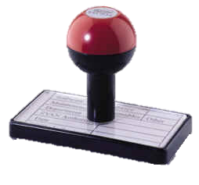
sixth
fifth
saying
6. John 19.30 ~ So when Jesus had received the sour wine, He said, “It is finished!” And bowing His head, He gave up His spirit.
-------------------------------------------------
tetelestai ~ to complete or to perfect
DUE BILL
Perfect tense ~ action occurring in the past, never to be repeated
For sins against the Heavenly Father
Paid in full
Tetelestai
Balance due:
Eternal torment;
Infinite wrath
the seven last sayings of Christ from the cross

Slide 19
sixth
saying
the seven last sayings of Christ from the cross

Slide 20
seventh
sixth
saying
7. Luke 23.46 ~ And when Jesus had cried out with a loud voice, He said, “Father, into Your hands I commit My spirit.” Having said this, He breathed His last.
the seven last sayings of Christ from the cross

Slide 21
seventh
saying
the seven last sayings of Christ from the cross

Slide 22
seventh
saying
In Evil Long I Took Delight – John Newton
In evil long I took delight,
Unawed by shame or fear,
Till a new object struck my sight,
And stop’d my wild career:
I saw One hanging on a Tree
In agonies and blood,
Who fix’d His languid eyes on me.
As near His Cross I stood.
the seven last sayings of Christ from the cross

Slide 23
seventh
saying
In Evil Long I Took Delight – John Newton
Sure never till my latest breath,
Can I forget that look:
It seem’d to charge me with His death,
Though not a word He spoke:
My conscience felt and own’d the guilt,
And plunged me in despair:
I saw my sins His Blood had spilt,
And help'd to nail Him there.
the seven last sayings of Christ from the cross

Slide 24
seventh
saying
In Evil Long I Took Delight – John Newton
Alas! I knew not what I did!
But now my tears are vain:
Where shall my trembling soul be hid?
For I the Lord have slain!
A second look He gave, which said,
“I freely all forgive;
This blood is for thy ransom paid;
I die that thou may’st live.”
the seven last sayings of Christ from the cross

Slide 25
seventh
saying
In Evil Long I Took Delight – John Newton
Thus, while His death my sin displays
In all its blackest hue,
Such is the mystery of grace,
It seals my pardon too.
With pleasing grief, and mournful joy,
My spirit now is fill’d,
That I should such a life destroy,
Yet live by Him I kill’d!
the seven last sayings of Christ from the cross

Slide 26
seventh
saying
the seven last sayings of Christ from the cross

